Slide 1
IDENTIFYING THE DISEASES IN RICE CROPS USING IMAGE PROCESSING
Project Guide: Mrs. Reshma B
Project Coordinator: Mr. Manjesh R
Team Members:
Nithin D Souza - 4SN16CS726
Sapthami - 4SN16CS735
Spoorthi Jain - 4SN16CS744
Vivek K S - 4SN16CS757

Slide 2
INTRODUCTION
Image processing is a technique that carries out few functioning in an image, with a purpose to get an intensified picture or to take out some beneficial data from it.
The project focuses on providing the information regarding the diseases in a rice crops and about pesticide/insecticide to be used for it.
An android application named RiceCropExpert is developed and the farmer uploads the picture of the diseased crop in app.
Image Processing Techniques are carried out and the result including the disease name and the name of fertilizers to be used are sent to the farmer through app.

Slide 3
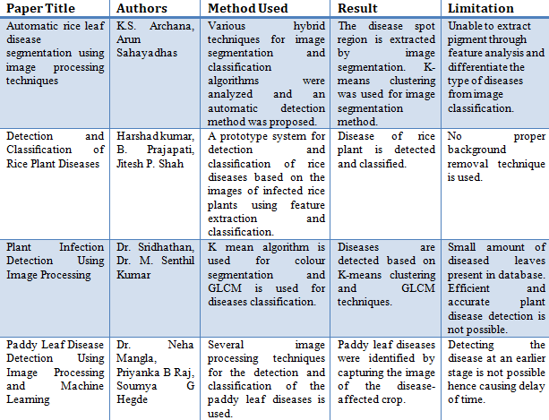
Literature Survey

Slide 4
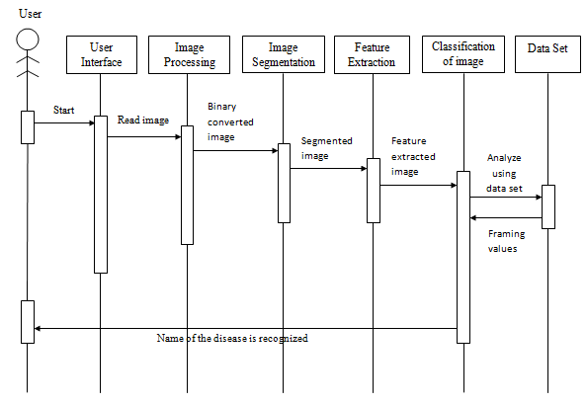
Sequence Diagram

Slide 5
Implementation Details
The user captures the photo of the diseased crop and uploads the photo in app.
The photo uploaded by the user is then processed through MATLAB.
The photo is clustered using k-means clustering algorithm by the system.
The photo then undergoes segmentation.
The extracted features of the photo are processed further to classify the name of disease present in the image.
The details are updated on the application to notify the user about the disorder in rice crop and the fertilizers to be used.

Slide 6
Advantages and Limitations
Advantages:
The preferred technique can find the disorders with a bit computational attempt.
The plant disorders may be found at the preliminary level only by this method so that the pest management machines could be utilized to resolve pest problems at the same time by decreasing threats to human and the surroundings.
Limitations:
Unable to draw out the shade through feature evaluation.
Also, the entire procedure defined in this project can be done as an automatic procedure so that the outcome can be conveyed in a completely quick span of time.

Slide 7
Applications
Most of the farmers might not have knowledge about how much amount of fertilizer are required and which pesticide/insecticide to be used to cure the diseased crop.
It may result in inequitable use of fertilizer. Hence the expansion of crop gets damaged.
The proposed system gives disease name with the name of pesticide/insecticide to used via the android application developed.
This attain benefits in controlling massive region of crops.
Using this approach, the rice crop diseases can be detected at the earlier stage itself and the pest control devices will be used to solve pest problems, decreasing risks to people and the surrounding.

Slide 8
Conclusion
Control, quick and precise disease finding plays an important position in disease recognition of rice crops.
Most of the present image segmentation technique may not have computerized rice crop disease recognition.
The recently observed segmentation algorithm, that is k-means clustering will vary the spotted location from backdrop of picture.
The project provides the information regarding the diseases in a rice crop.
The outcome of the system consists of name of the disease and the name of pesticide to be used is retrieved.

Slide 9
References
Romana Tazeen, Shilpa H N, Usha P, Mrs. Jayanthi M G, Dr. Shashikumar D R, "Image Processing System for Fertilization Management of Crops", communicated to International Journal of Engineering Research(IJER), 2016.
Al-Hiary, H.S. Bani-Ahmad, M. Reyalat, M. Braik, and Z. AlRahamneh, “Fast and accurate detection and classification of plant diseases”, International Journal of Computer Applications, 17(1): 31-38, 2011.
Pallavi. S. Marathe, “Plant Disease Detection using Digital Image Processing and GSM”, International Journal of Engineering Science and Computing, pp. 10513-15, April 2017.
Vijai Singh, A.K. Misra, “Detection of Plant Leaf Diseases using Image Segmentation and Soft Computing Techniques”, Information Processing in Agriculture, pp. 41–49, 2017.
Sujatha. R, Y. Sravan Kumar and Garine Uma Akhil, “Leaf Disease Detection using Image Processing”, Journal of Chemical and Pharmaceutical Sciences, pp 670 – 672, March 2017.

Slide 10
THANK YOU

